Slide 1
How to create users with only a Primary Identifier
Yoel Kortick May 2024

Slide 2
Agenda
The question
The answer
Making only the Primary Identifier a required field for public users
An example

Slide 3
The question

Slide 4
The question
As a government unit, patron information privacy is at their top concern. The library representative understands our compliance towards those privacy standards and circulation services. At the same time, they are planning to input minimal patron information into the system but with the smoothest workflows with only a primary identifier.
Would you mind sharing with your expertise with them and see how we can do this properly in Alma.

Slide 5
The answer

Slide 6
The answer
There are two options here:
Option One
  Set up the system such that for users of type “public” (and if desired also “staff” users) the only required field is “Primary Identifier”.
  All fulfillment workflows can be used with a patron which has only Primary Identifier as can workflows with users which have additional fields.
Option Two
  Set up the system such that for users of type “public” (and all other types of users including “staff” users) any fields you want will be required and all fields can be used.
  Activate the “Anonymization of personal information data” to remove personal information from Alma when it is no longer required for operational purposes.

Slide 7
The answer
With option one there will be no personal data in Alma at all. Users will have only a Primary Identifier.
With option two there will be personal data in Alma. The personal data will be anonymized in Alma Analytics.

Slide 8
The answer
In the example here we will use option one.
If you wish to use option two see
  Configuring Fulfillment Anonymization Jobs
  Transactional Anonymization in Alma and the effect on Alma Analytics
  Non-Transactional Anonymization in Alma and the effect on Alma Analytics
  Anonymization in Alma Analytics - a reference source

Slide 9
Making only the Primary Identifier a required field for public users

Slide 10
Making only the Primary Identifier a required field for public users
In order to make only the Primary Identifier a required field for public users do as follows:
Access the “User Registration Form” at: Configuration > User Management > User Details > User Registration Form
Make all fields not mandatory by unchecking all boxes in the “Mandatory for Public” column
  Note that even though we will uncheck all boxes in the “Mandatory for Public” column, the Primary Identifier and password will still be mandatory because these are always a mandatory fields.

Slide 11
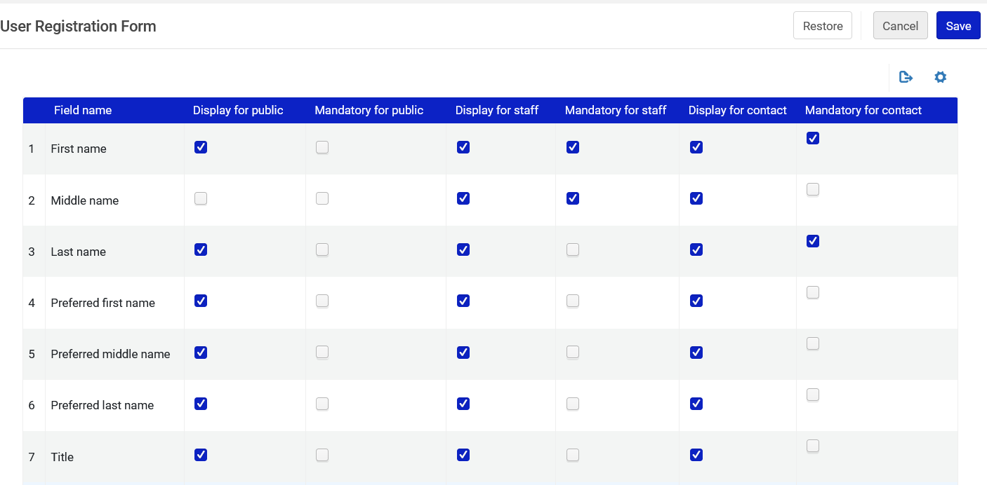
Making only the Primary Identifier a required field for public users
Make all fields not mandatory by unchecking all boxes in the “Mandatory for Public” column
This is only a partial screenshot of the page. There are many more fields.

Slide 12
An example

Slide 13
An example
We will now add a new user with only “Primary Identifier”.
We will then show that this user functions like all other users (which have more personal information in Alma) by
  Loaning an item to this user
  Having the user log into discovery
  Having this user make a physical item request
  Having the user view his or her loans and requests

Slide 14
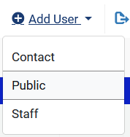
An example
For “Admin > Manage Users” we will create new user of type “Public”

Slide 15
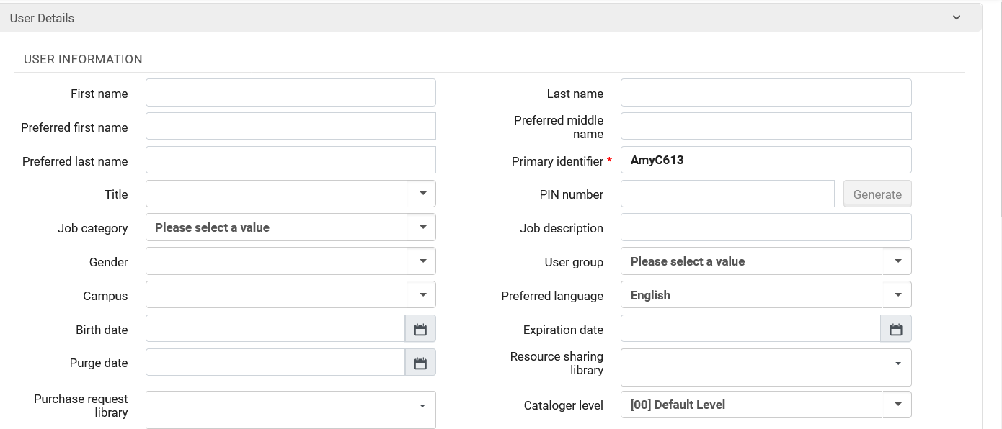
An example
We will assign the user a Primary Identifier and fill in no other fields
The Primary Identifier is AmyC613
This is the only required field. It has a red asterisk showing that it is mandatory.

Slide 16
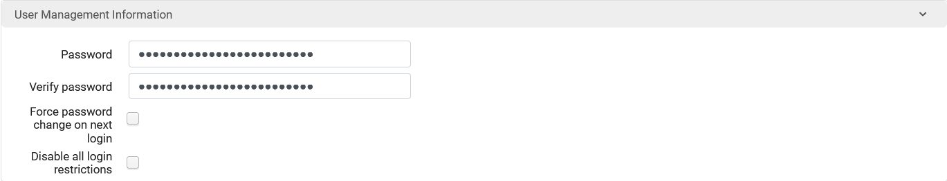
An example
The password is filled in

Slide 17
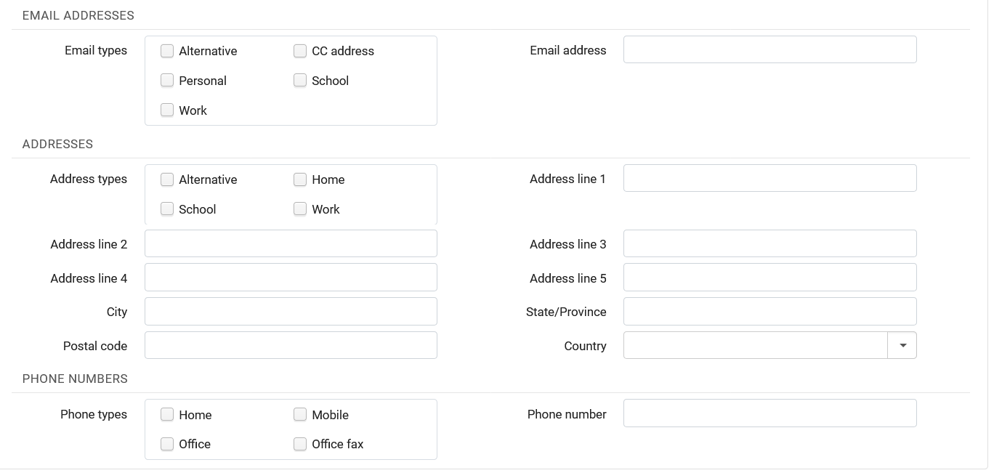
An example
These fields are not mandatory, and we will not fill them in

Slide 18
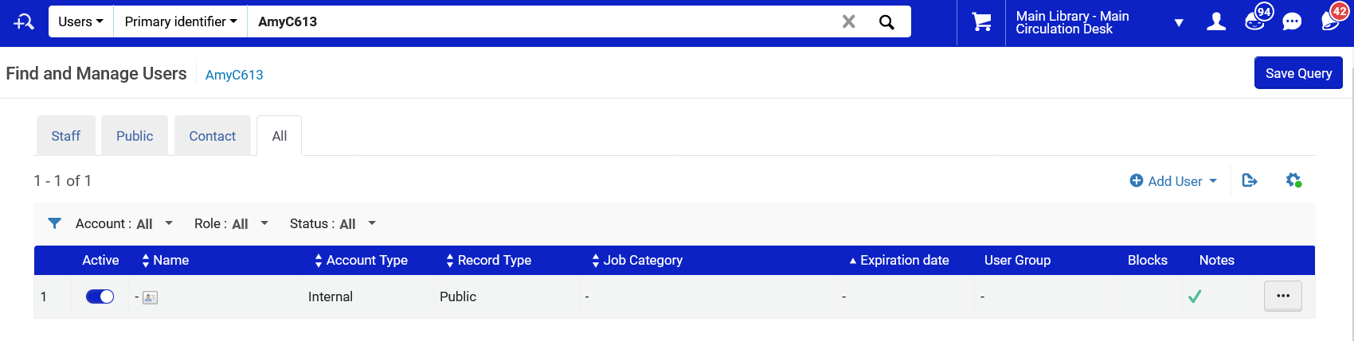
An example
The user can be retrieved

Slide 19
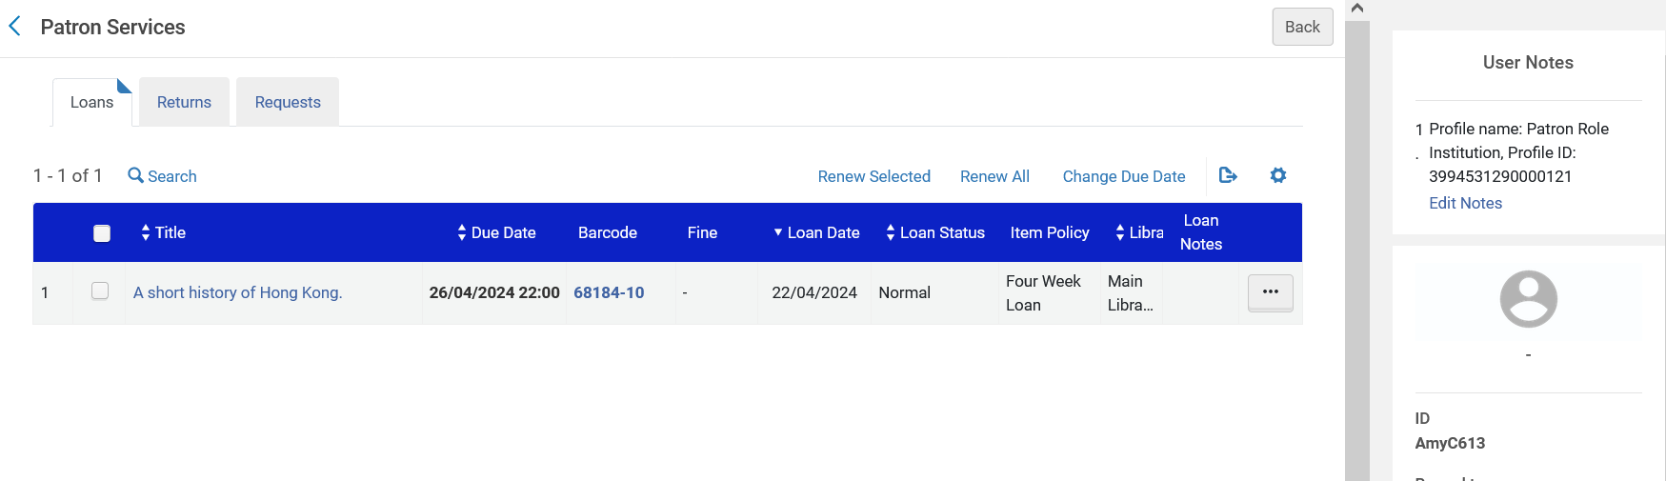
An example
Items can be loaned to the patron

Slide 20
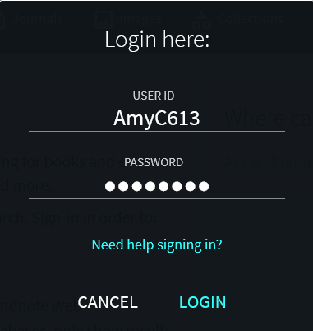
An example
The patron can log into discovery

Slide 21
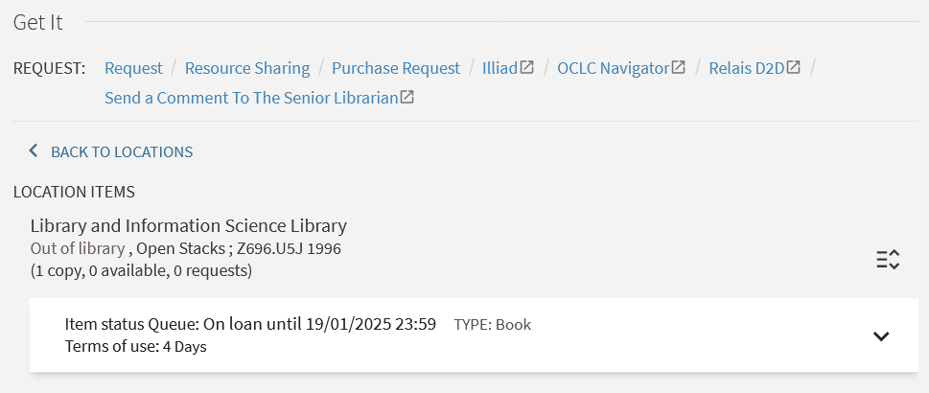
An example
The patron can make requests

Slide 22
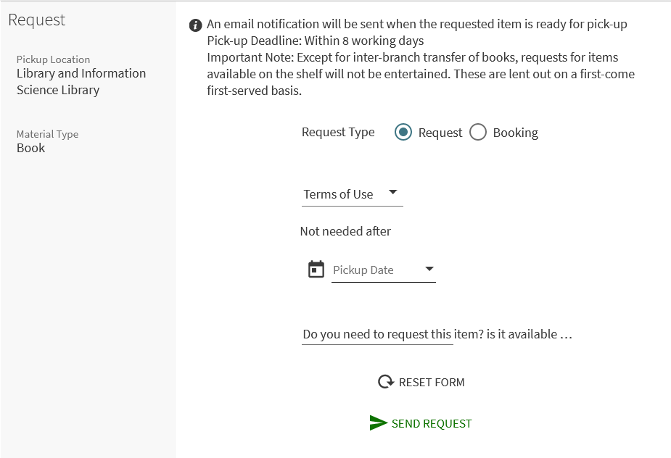
An example
The patron can make requests

Slide 23
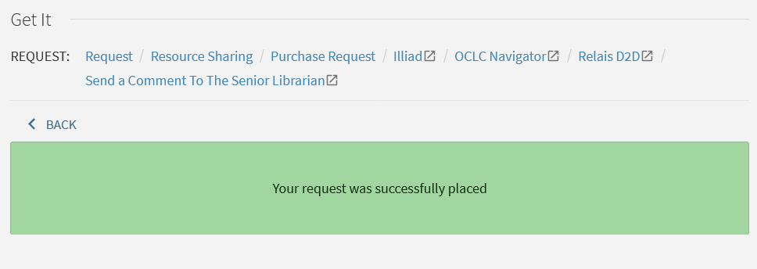
An example
The patron can make requests

Slide 24
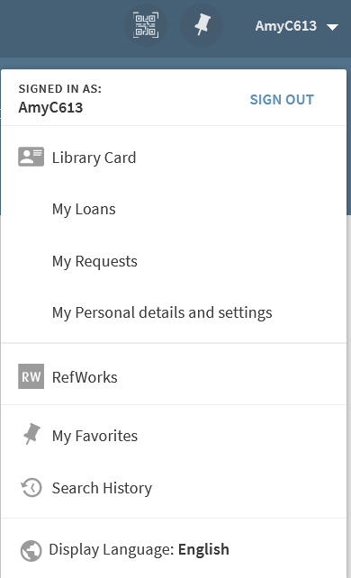
An example
The patron can view loans and requests

Slide 25
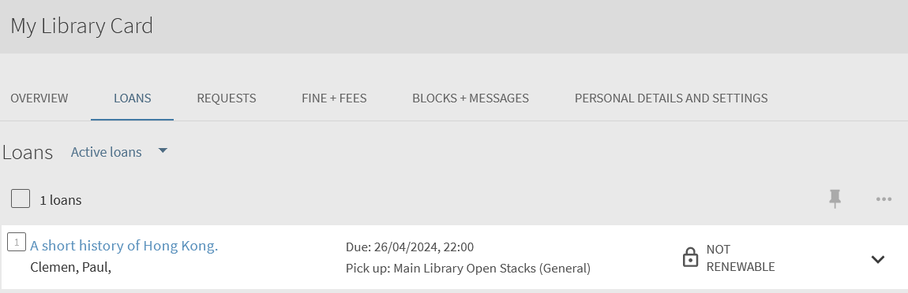
An example
The patron can view loans and requests

Slide 26
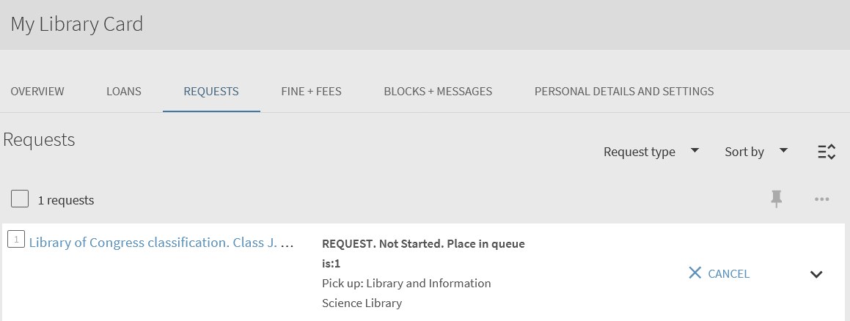
An example
The patron can view loans and requests

